Slide 1
ALCOHOLS

Slide 2
COMPARE STRUCTURE OF WATER AND METHANOL
In both the oxygen is sp³ hybridized and tetrahedral.
The H—O—H angle in water is 104.5°.
The C—O—H angle in methyl alcohol is 108.9° CH₃

Slide 3
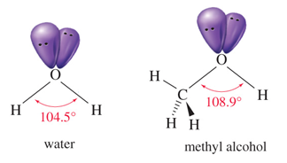


Slide 4
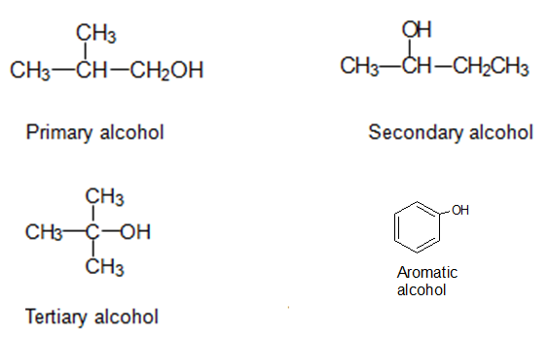
CLASSIFICATION OF ALCOHOLS

Slide 5
IUPAC NOMENCLATURE
Find the longest carbon chain containing the carbon with the —OH group.
Drop the -e from the alkane name, of the chain and add -ol.
Assign the carbon with the —OH group the lowest number possible.
Number and name all substituents and write them in alphabetical order.

Slide 6
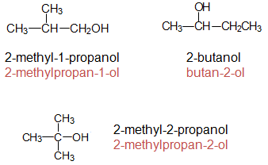
EXAMPLES OF NOMENCLATURE

Slide 7
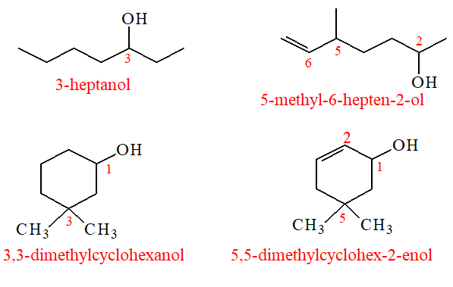

Slide 8
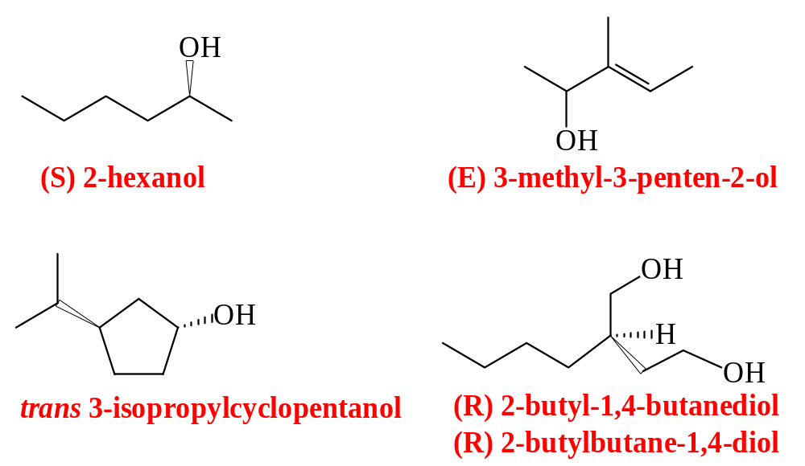

Slide 9
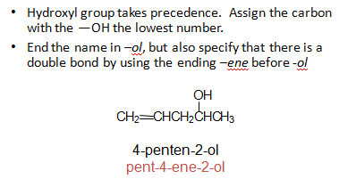
ALKENOLS (ENOLS)

Slide 10
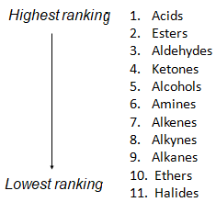
NAMING PRIORITY

Slide 11
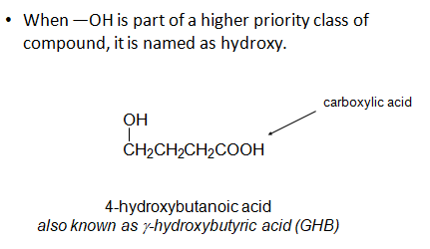
HYDROXY SUBSTITUENT

Slide 12
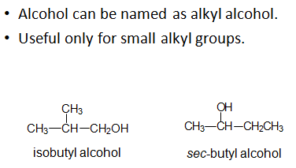
COMMON NAMES

Slide 13
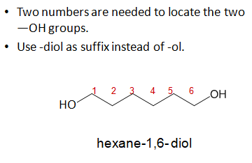
NAMING DIOLS

Slide 14
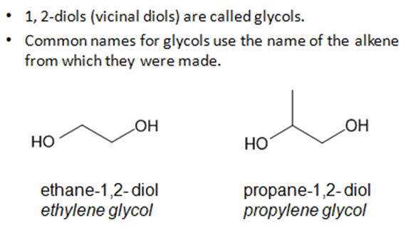
GLYCOLS

Slide 15
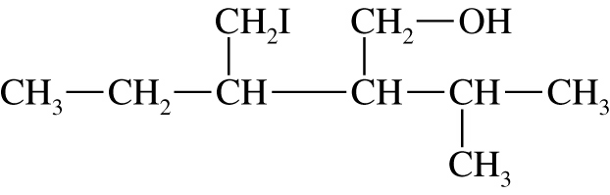
EXAMPLE
Give the systematic (IUPAC) name for the following alcohol.
Notes:
Copyright © 2006 Pearson Prentice Hall, Inc.

Slide 16
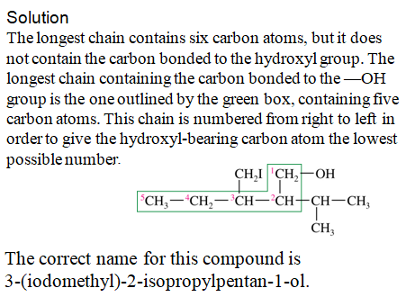

Slide 17
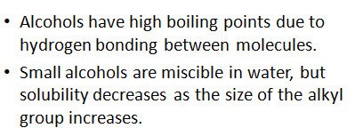
PHYSICAL PROPERTIES

Slide 18
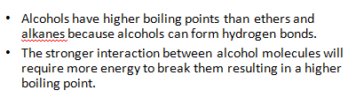

BOILING POINTS OF ALCOHOLS

Slide 19

SOLUBILITY IN WATER

Slide 20
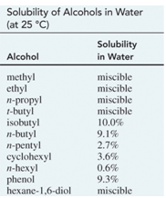

Slide 21
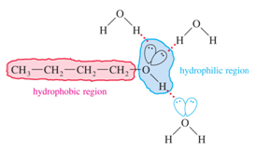

Slide 22
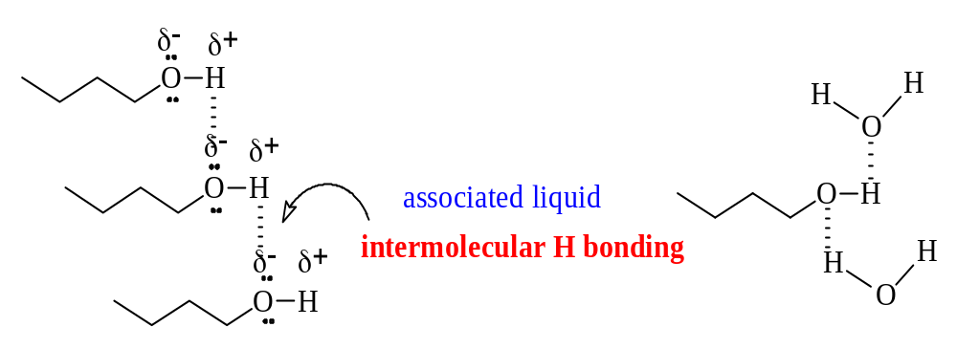
INTERMOLECULAR
H-BONDING

Slide 23
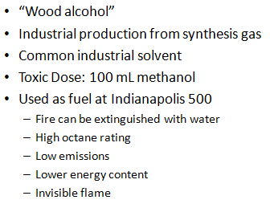
METHANOL

Slide 24
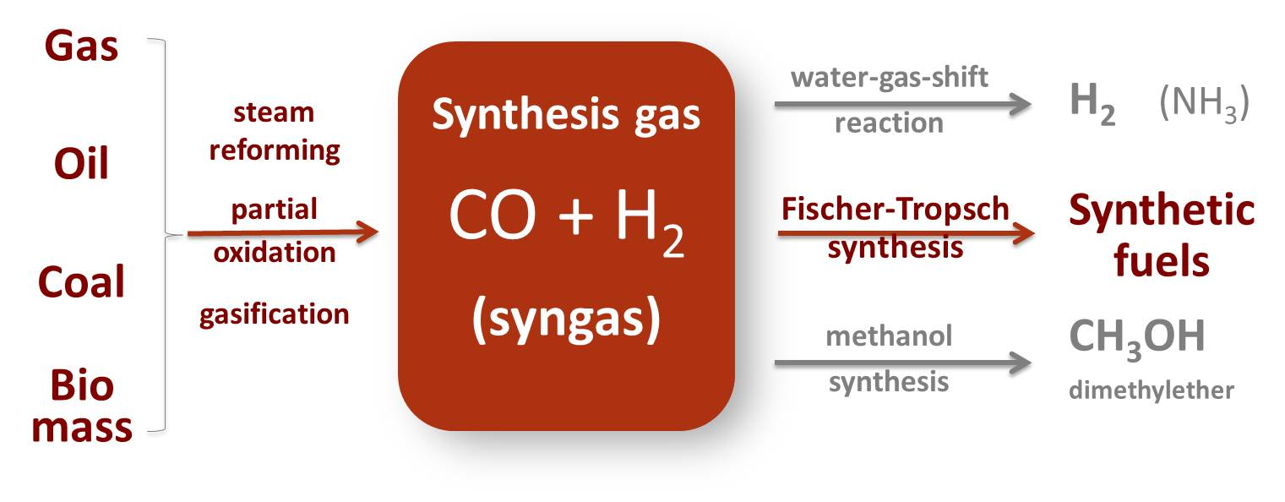

Slide 25
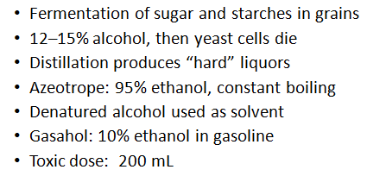
ETHANOL

Slide 26
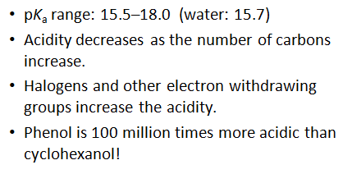
ACIDITY OF ALCOHOLS

Slide 27
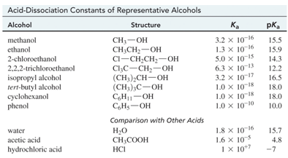
TABLE OF K_{a} VALUES

Slide 28
FORMATION OF ALKOXIDES
Ethanol reacts with sodium metal to form ethoxide (CH₃CH₂ONa), a strong base commonly used for elimination reactions.
The more hindered alcohols like
2-propanol or tert-butanol react faster with potassium than with sodium.

Slide 29
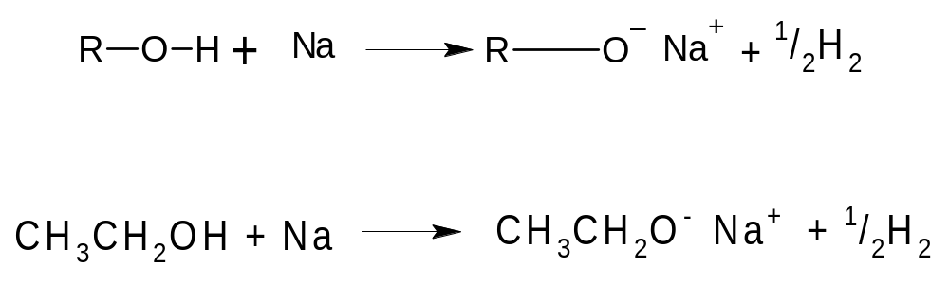

Slide 30
SYNTHESIS OF ALCOHOLS
(PREPARATIONS OF ALCOHOLS)

Slide 31
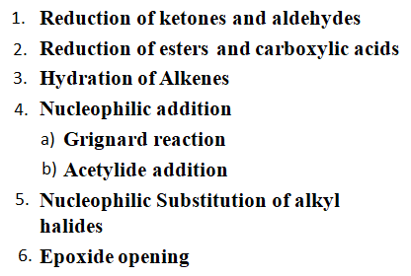
PREPARATION OF ALCOHOLS

Slide 32
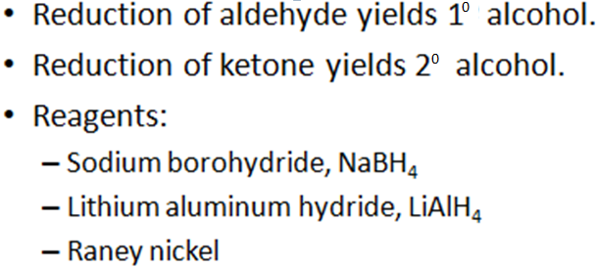
REDUCTION OF CARBONYL COMPOUNDS

Slide 33
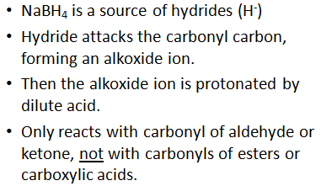
SODIUM BOROHYDRIDE

Slide 34
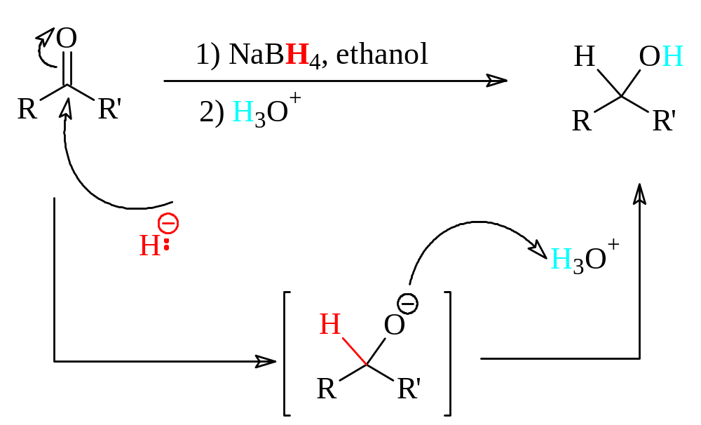
REDUCTION OF KETONEs & ALDEHYDES
NaBH₄ Reduction

Slide 35
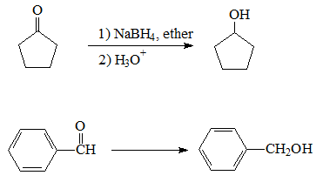
EXAMPLES

Slide 36
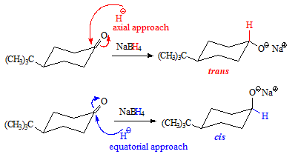
SUBSTITUTED CYCLOHEXANE GIVES TWO ALCOHOL PRODUCTS

Slide 37
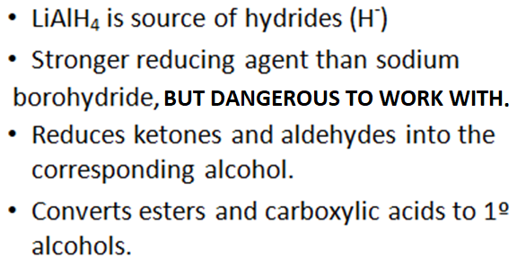
LITHIUM ALUMINUM HYDRIDE

Slide 38
* Lithium Aluminum Hydride can cause headache, muscle weakness, loss of coordination, confusion, seizures and coma.
* High exposure can affect the thyroid gland function resulting in an enlarged thyroid (goiter).
* Lithium Aluminum Hydride is a REACTIVE CHEMICAL and an EXPLOSION HAZARD

Slide 39
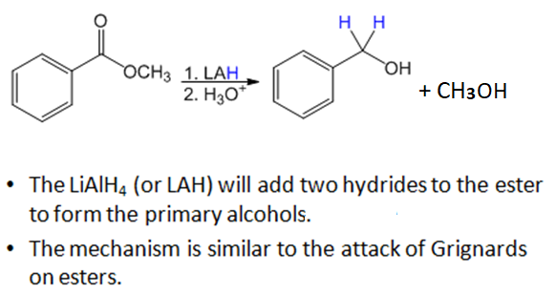
REDUCTION WITH LiALH₄

Slide 40
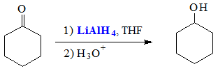
LiAlH₄ REDUCTION
A STRONGER REDUCING AGENT

Slide 41
LiAlH₄ will reduce:
.Ketones to 2⁰ alcohols
.Aldehydes to 1⁰ alcohols
.Carboxylic acids and esters
to 1⁰ alcohols

Slide 42
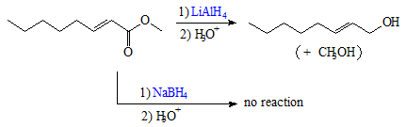
LiAlH₄ IS A MUCH STRONGER REDUCING AGENT

Slide 43
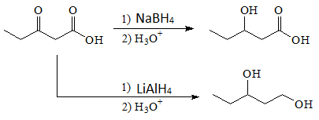
NaBH₄ IS MORE SELECTIVE

Slide 44
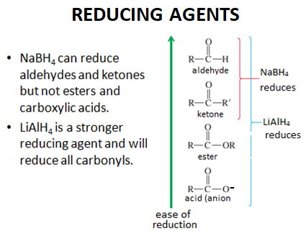

Slide 45
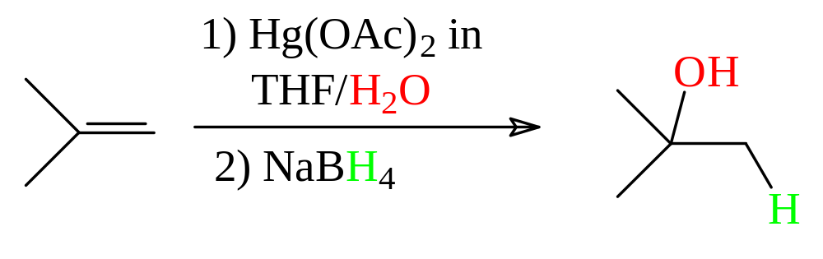
OXYMERCURATION HYDRATION
MARKOVNIKOV

Slide 46
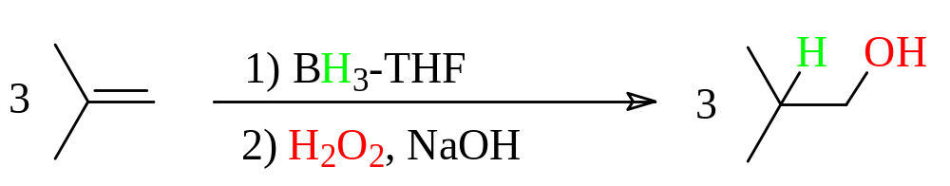
HYDROBORATION HYDRATION
ANTI-MARKOVNIKOV

Slide 47
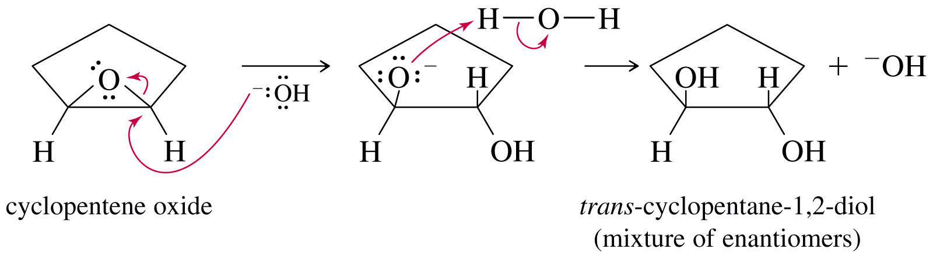
BASE CATALYZED RING-OPENING OF EPOXIDES

Slide 48
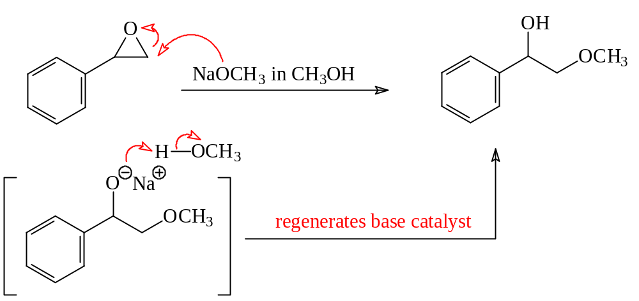
BASE OPENS RING FROM UNHINDERED SIDE

Slide 49
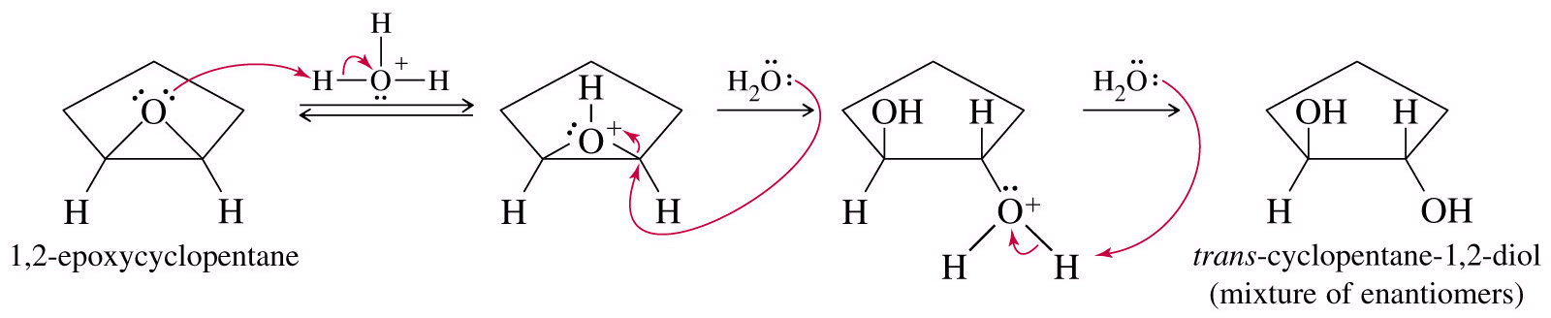
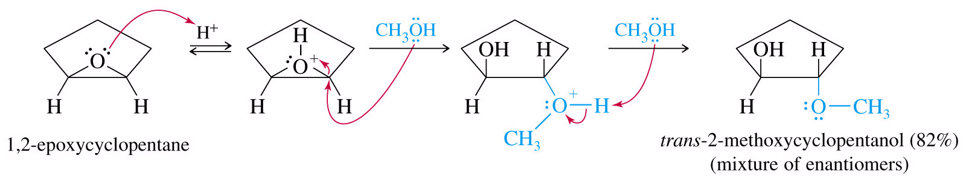
ACID CATALYZED RING-OPENING
AQUEOUS AND IN ALCOHOL

Slide 50
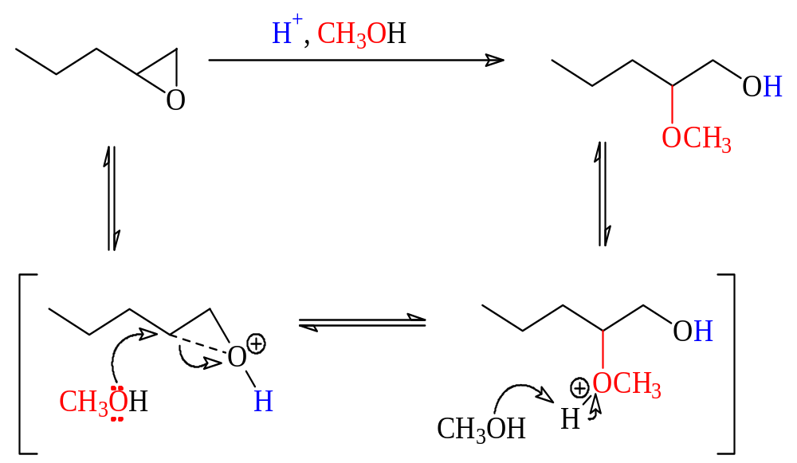
REGIOCHEMISTRY
RING OPENS AT MORE HINDERED SITE

Slide 51
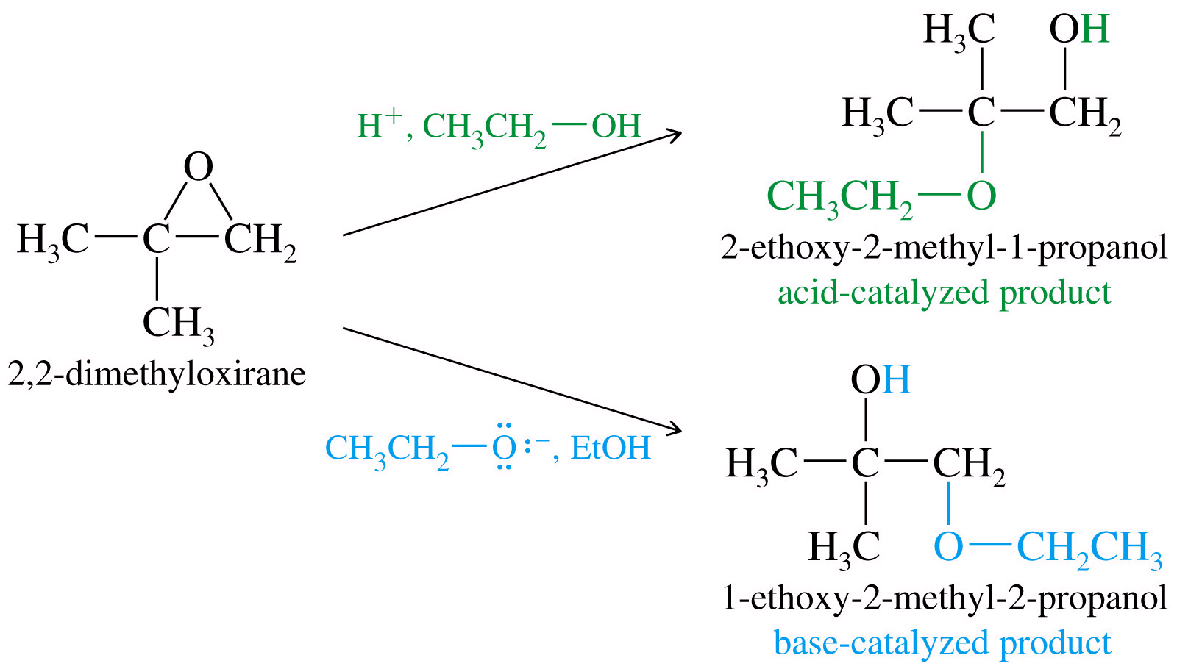
DIFFERENT REGIOSOMERS

Slide 52
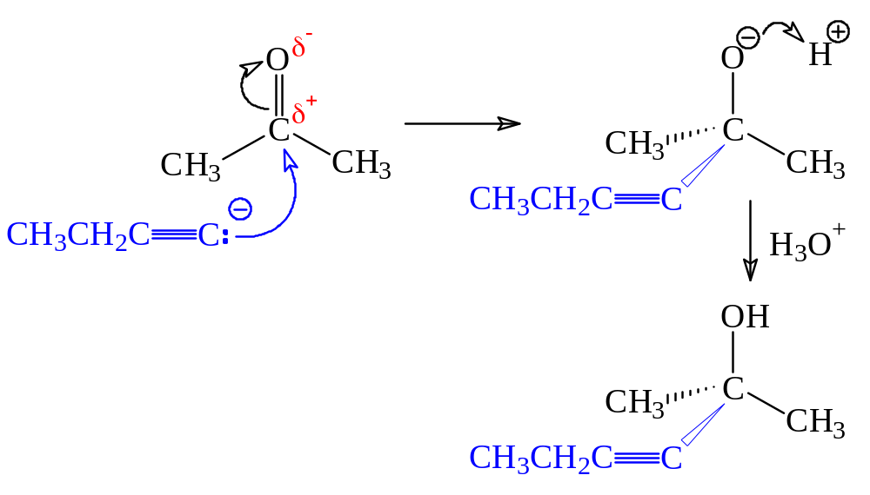
NUCLEOPHILIC ADDITION TO CARBONYL COMPOUNDS
ACETYLIDES

Slide 53
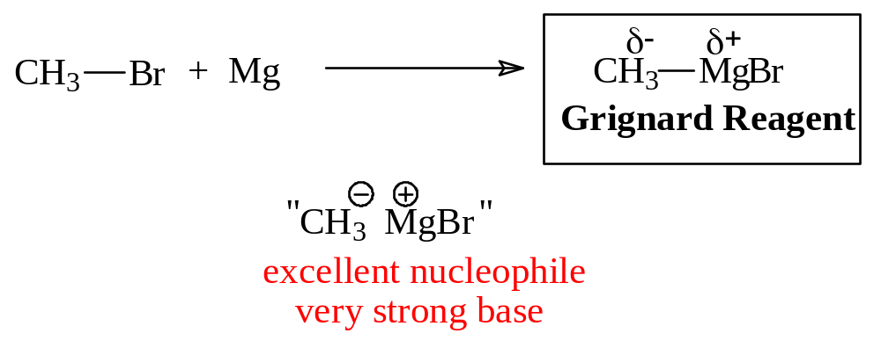
ORGANOMETALLIC CHEMISTRY
GRIGNARD REACTION

Slide 54
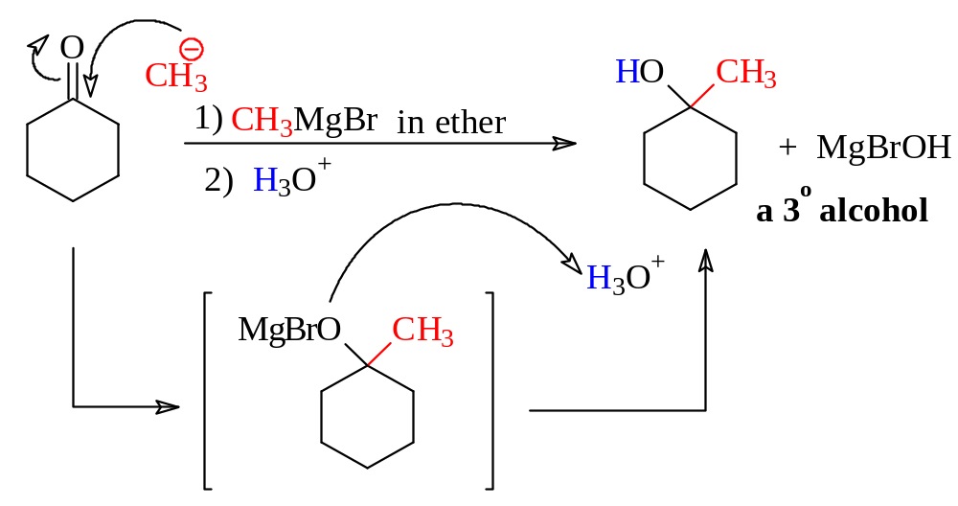
GRIGNARD REAGENTS REACT WITH KETONES TO FORM TERTIARY ALCOHOLS

Slide 55
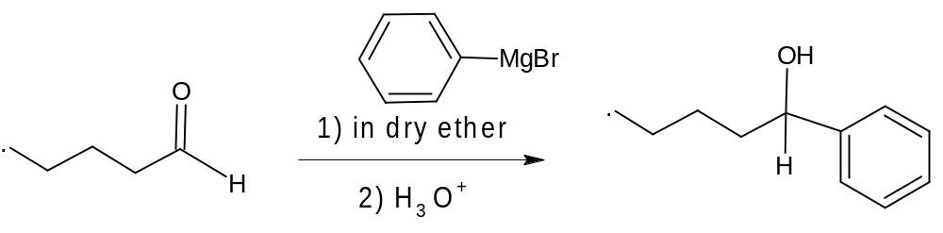
GRIGNARD REAGENTS REACT WITH ALDEHYDES TO FORM SECONDARY ALCOHOLS

Slide 56
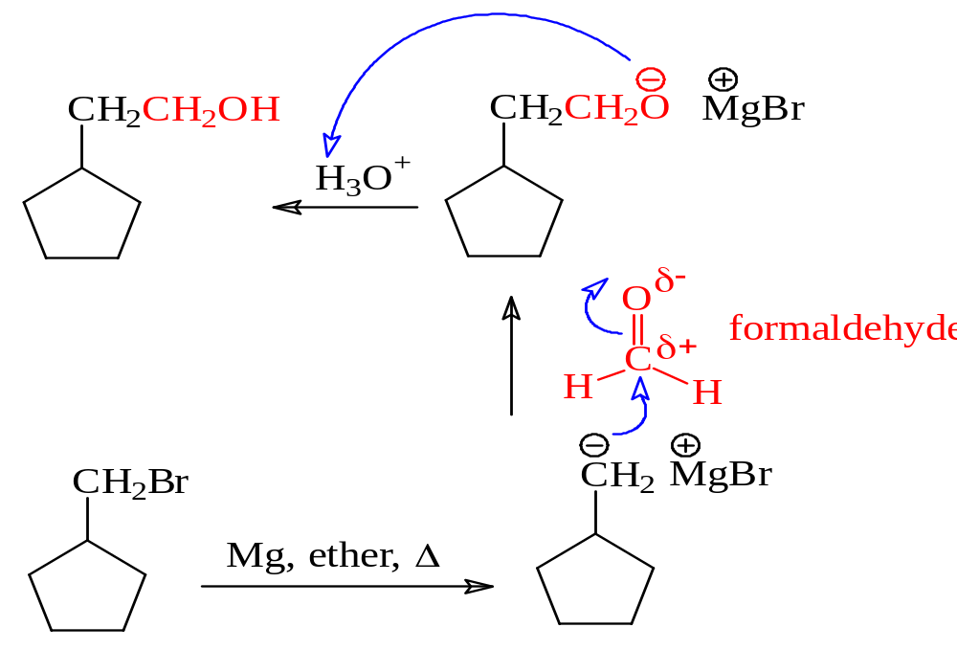
GRIGNARD REAGENTS REACT WITH FORMALDEHYDE TO FORM PRIMARY ALCOHOLS

Slide 57
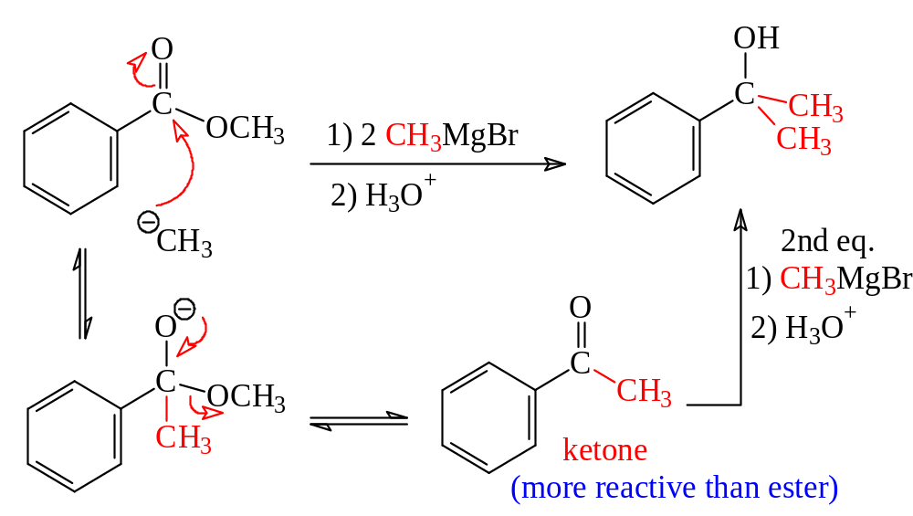
GRIGNARD REAGENTS REACT (TWICE) WITH ESTERS TO FORM
3^{O} ALCOHOLS

Slide 58

GRIGNARD REAGENTS OPEN EPOXIDES

Slide 59

RING-OPENING IS STERICALLY CONTROLLED

Slide 60

GRIGNARD SUMMARY

Slide 61

GRIGNARD SUMMARY

Slide 62

GRIGNARD REAGENTS ARE EXCEPTIONALLY STRONG BASES

Slide 63

AN EFFECTIVE USE OF THE BASICITY
IN ISOTOPIC LABELING

Slide 64


CATALYTIC HYDROGENATION

Slide 65
ALCOHOL REACTIONS

Slide 66

ALCOHOL REACTIONS

Slide 67

SUMMARY TABLE

Slide 68

SUMMARY TABLE

Slide 69

1º, 2º, 3º CARBONS

Slide 70

OXIDATION OF 1° ALCOHOLS

Slide 71

OXIDATION OF 2° ALCOHOLS

Slide 72

3° ALCOHOLS DON’T OXIDIZE

Slide 73

OTHER OXIDATION REAGENTS

Slide 74

BIOLOGICAL OXIDATION

Slide 75

ALCOHOL AS A NUCLEOPHILE

Slide 76

ALCOHOL AS AN ELECTROPHILE

Slide 77

FORMATION OF TOSYLATE ESTER

Slide 78

S_{N}2 REACTIONS OF TOSYLATES

Slide 79


Slide 80

REDUCTION OF ALCOHOLS

Slide 81

REACTION WITH HBr

Slide 82

REACTION WITH HCl

Slide 83

LIMITATIONS OF HX REACTIONS

Slide 84

REACTIONS WITH
PHOSPHORUS HALIDES

Slide 85

MECHANISM WITH PBr₃

Slide 86

REACTION WITH
THIONYL CHLORIDE

Slide 87

DEHYDRATION REACTIONS

Slide 88

DEHYDRATION MECHANISMS

Slide 89

ENERGY DIAGRAM

Slide 90

UNIQUE REACTIONS OF DIOLS

Slide 91

PINACOL REARRANGEMENT

Slide 92

PERIODIC CLEAVAGE
OF GLYCOLS

Slide 93

ESTERIFICATION

Slide 94


FISCHER ESTERIFICATION

Slide 95

TOSYLATE ESTERS

Slide 96

SULFATE ESTERS

Slide 97

NITRATE ESTERS

Slide 98

PHOSPHATE ESTERS

